Slide 1

SUMMER INTERSHIP INDIAN OIL COOPERATION LIMITED TONDIARPET TERMINAL (12/06/24 TO 12/07/24)
BY
KEERTHIVASAN G
2021505020

Slide 2
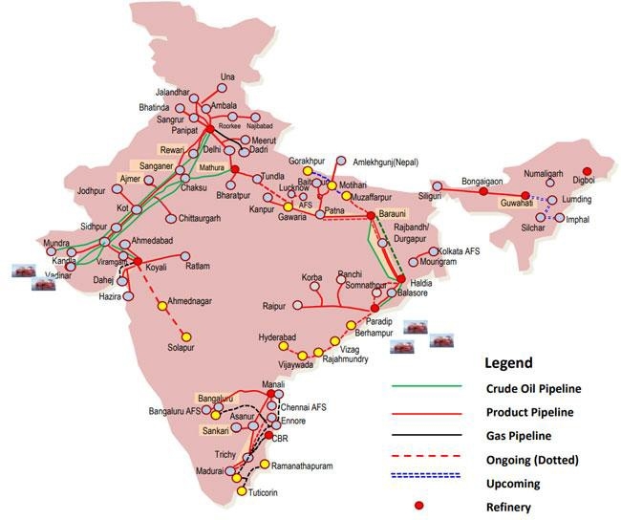
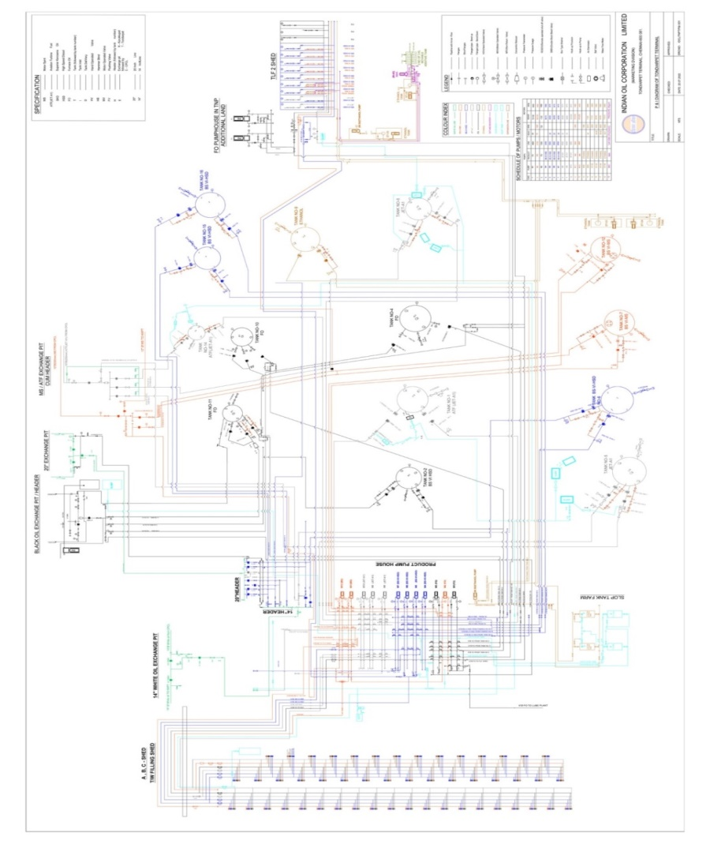
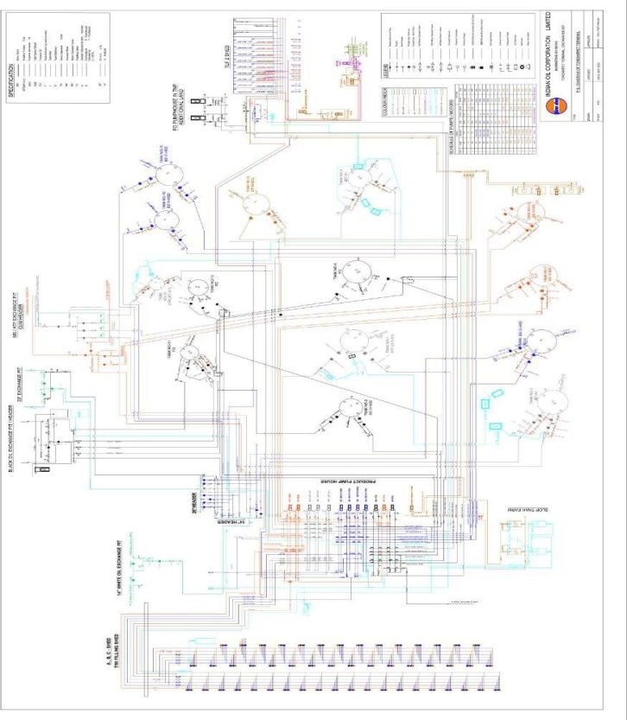
PIPELINE ACROSS INDIA TONDIARPET TERMINAL
DEDICATED PIPELINE FOR EACH PRODUCTS MS,HSD,ATF,FO FROM CPCL,FST,JETTY AND ETHANOL FROM SUGARCANE INDUSTRIES THROUGH TRUCKS
TANKS MS-2,HSD-3,ATF-2,FO-1,ETHANOL-4,WATER-3

Slide 3
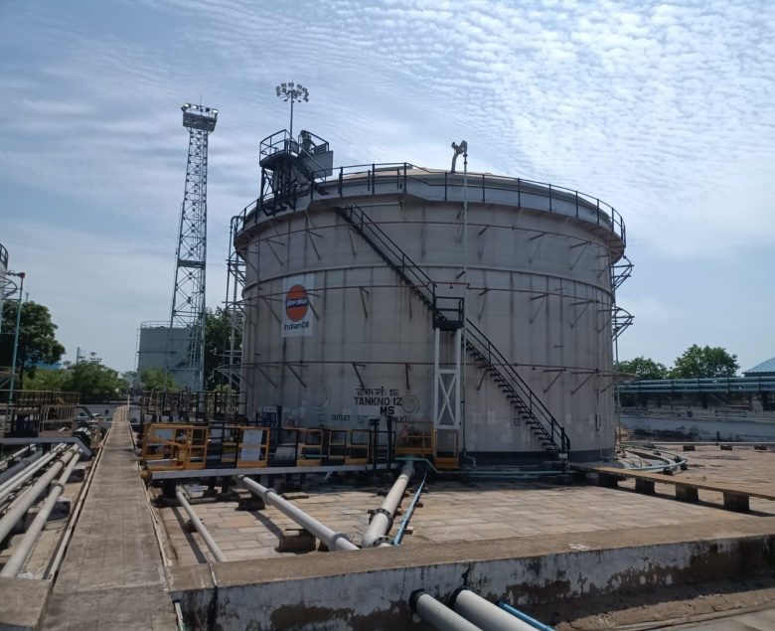
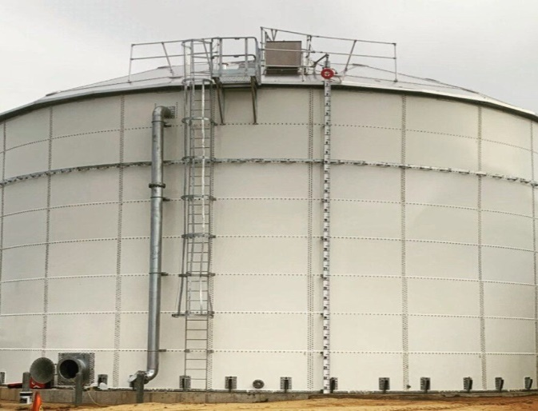
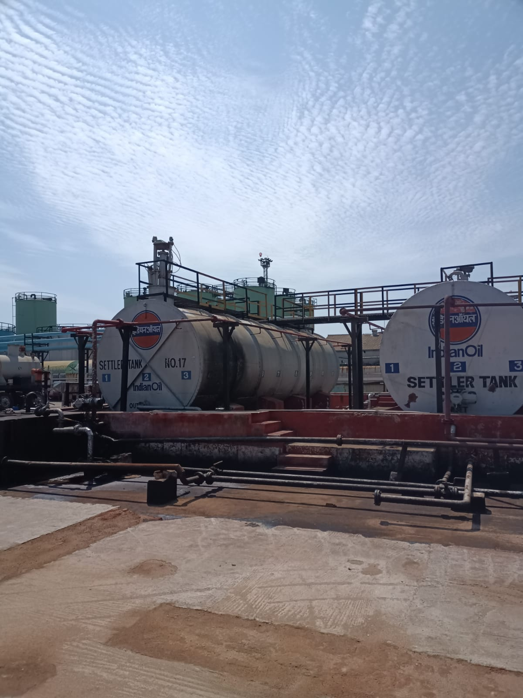
TANKS
Fixed roof tank(HSD,FO,ATF,
WATER)
Internal floating roof tank (MS)
Above ground horizontal tank(Ethanol)
For safety reason height specification
(HHH,HH,LL,LLL)
and air vents (normal, silica gel)

Slide 4
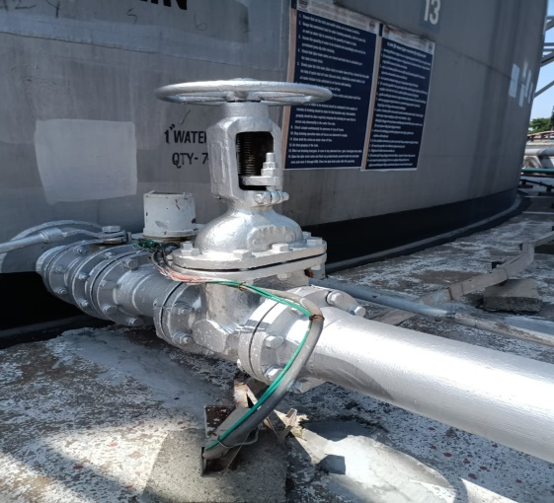
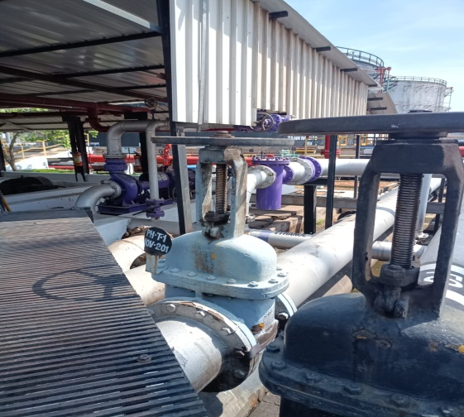
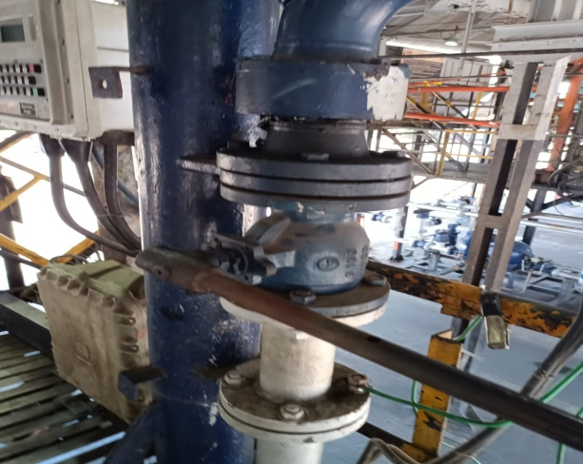
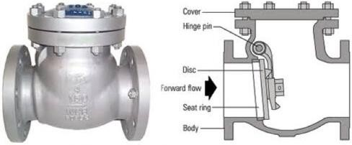
VALVES
Gate valves
Globe valves
Needle and butterfly valves
Check valves
DBBV(Double Block Bleed Valves)
ROSOV(Remote Operated Shut Off Valves)
Digital control valve (DCV)
Motor operated valve (MOV)

Slide 5
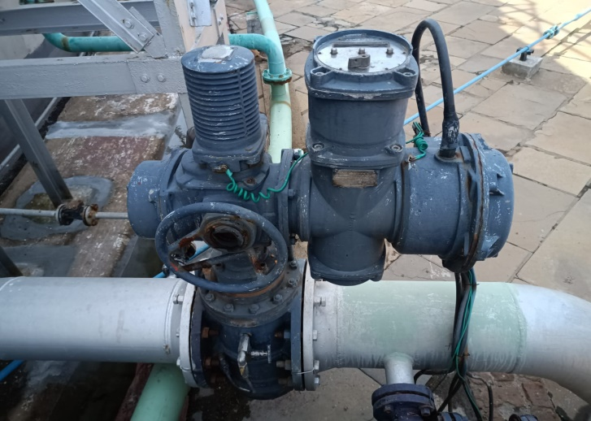
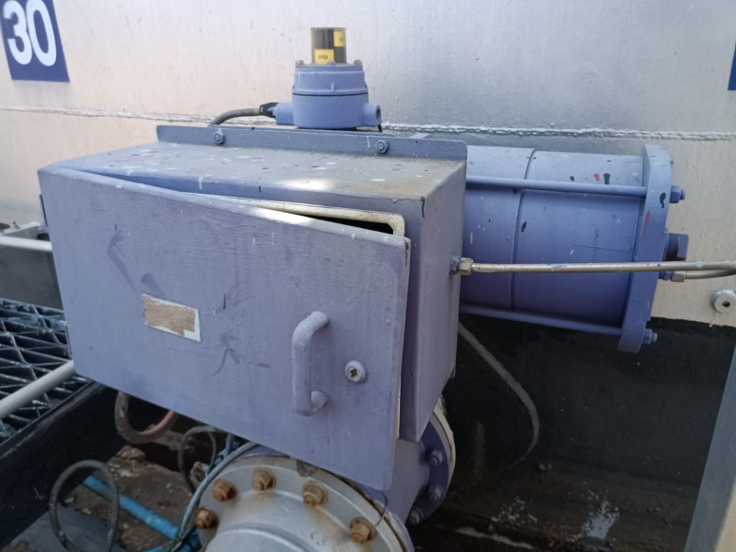
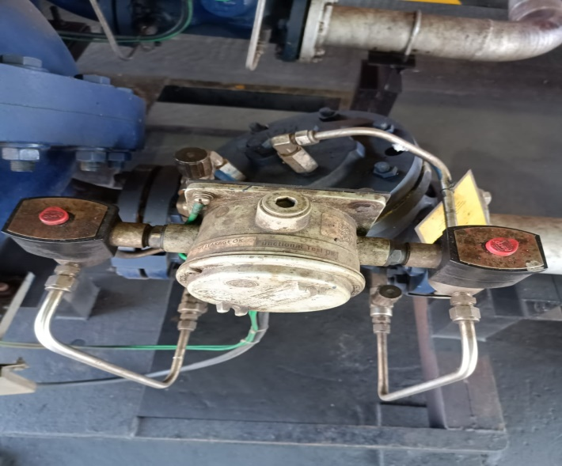
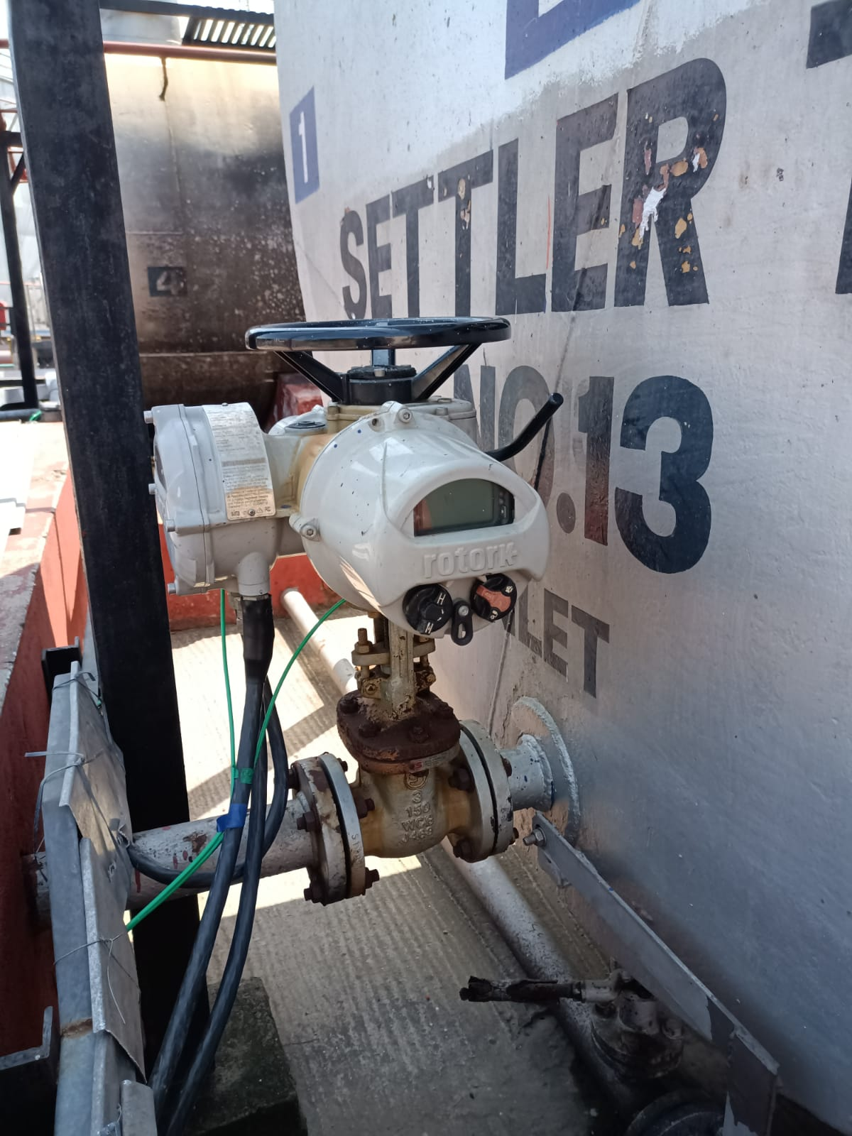

Slide 6
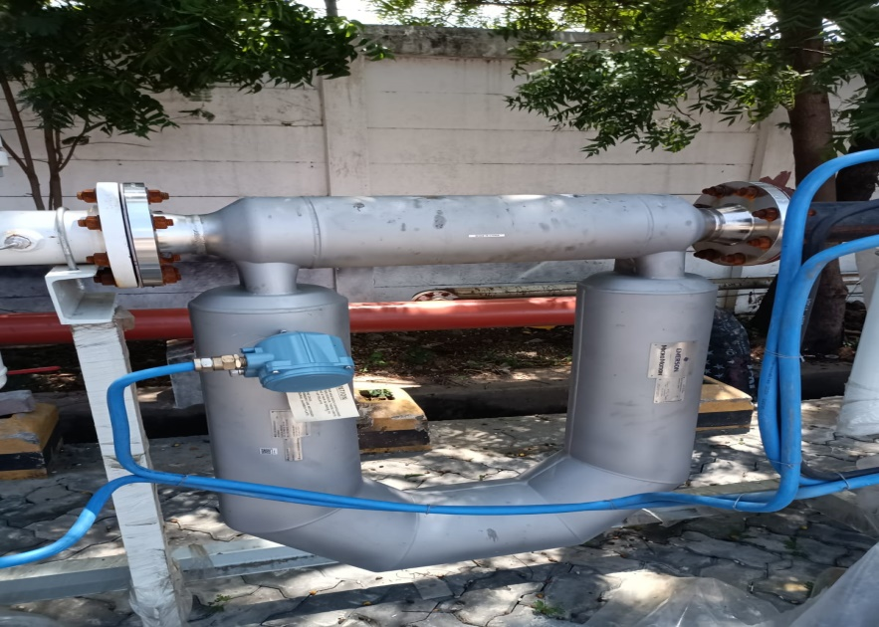
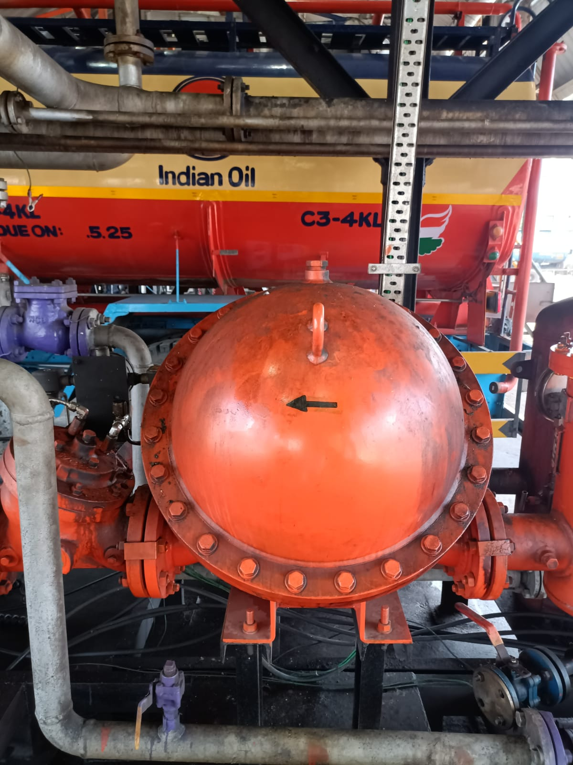
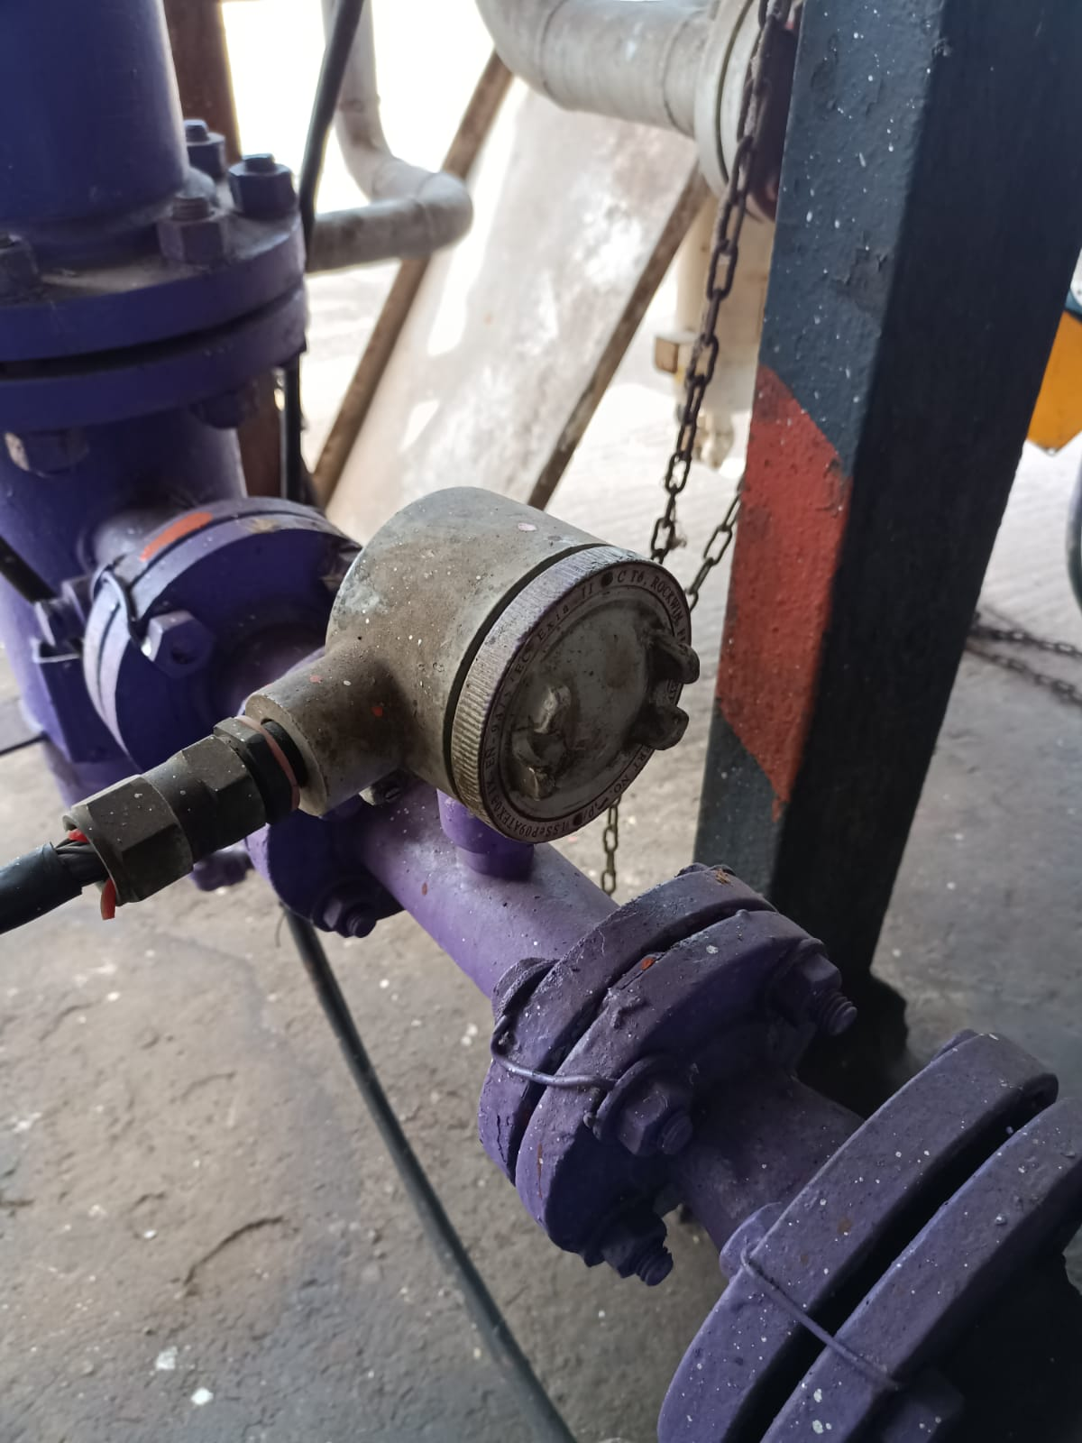
FLOW METERS
Mass flow meter(FO)
Positive displacement meter
(MS,HSD,ATF)
Turbine flow meter(Ethanol)

Slide 7
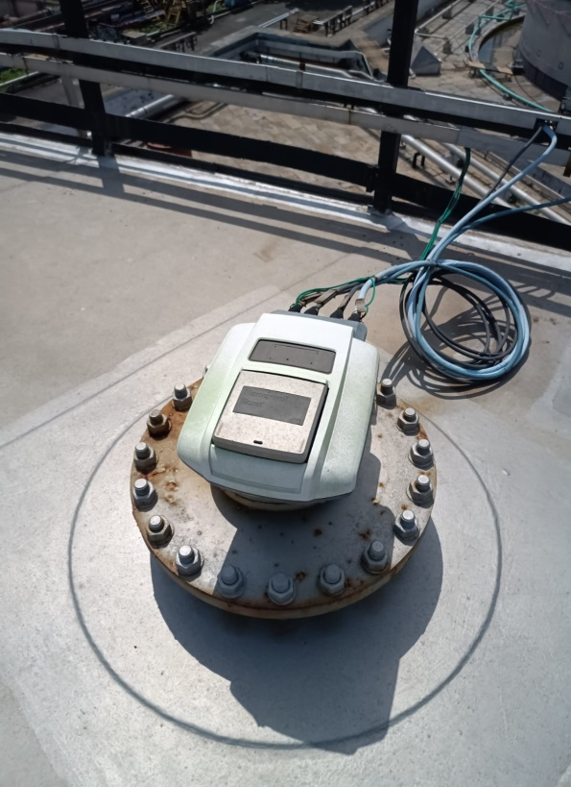
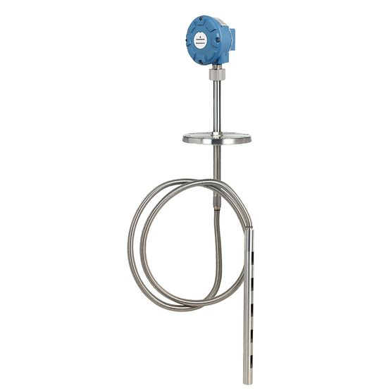
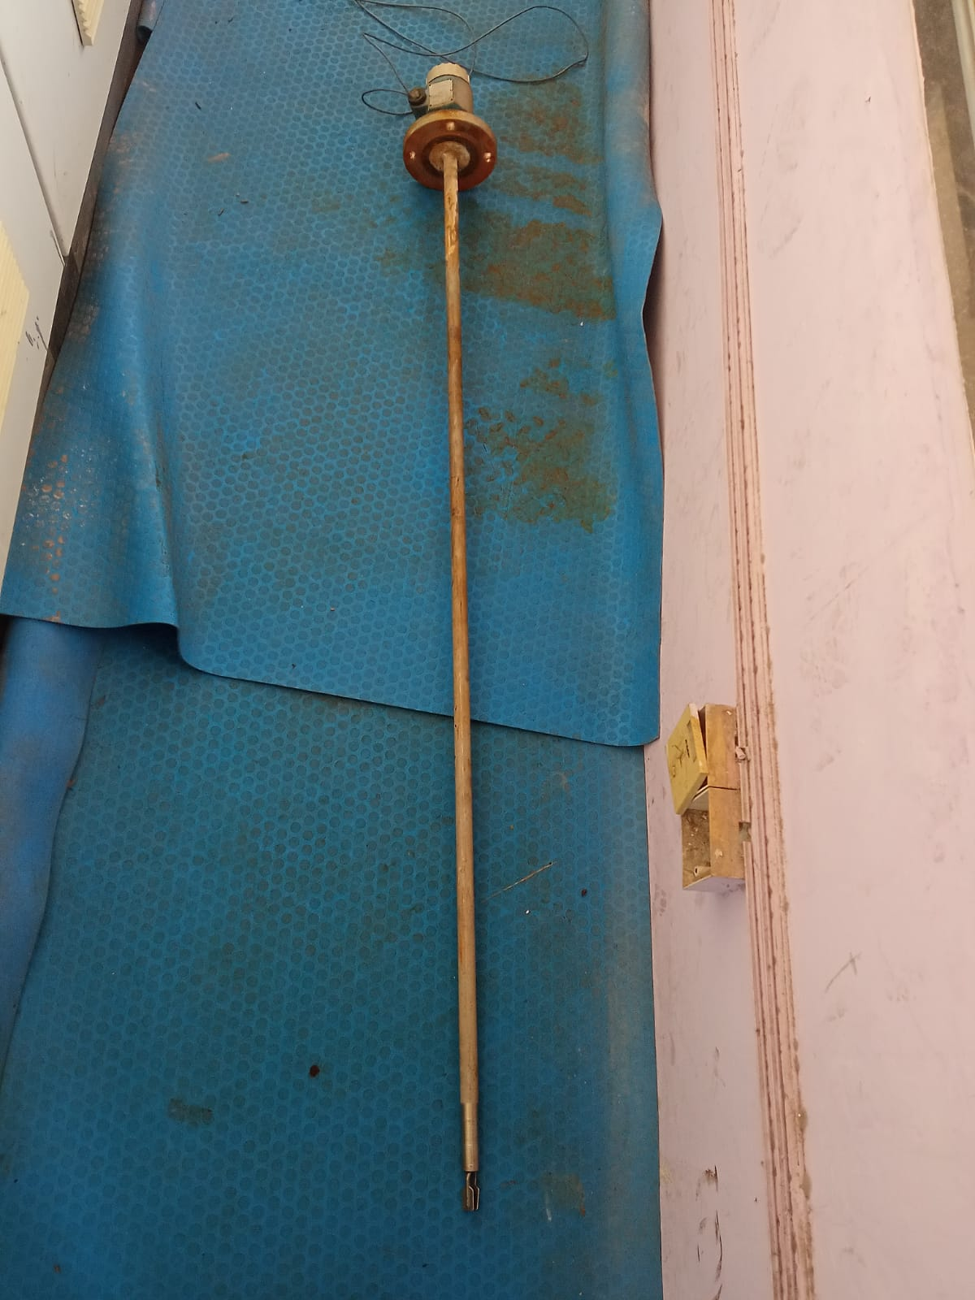
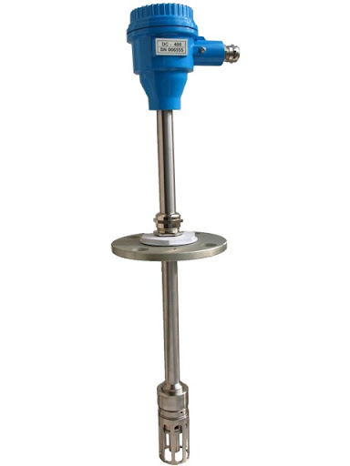
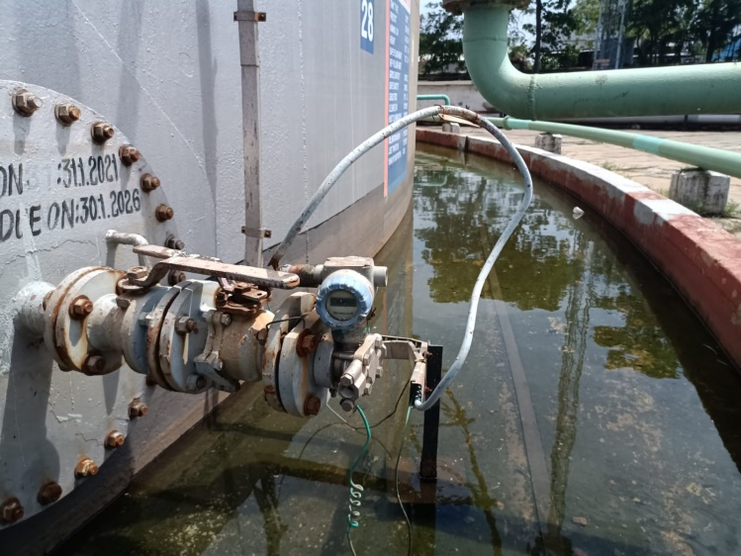
TANKS FARM
Radar gauge(primary , secondary)
MSTW(Multiple spot temperature and water sensor)
AOPS(Automatic Overspill sensor)
Pressure transmitter
Density probe

Slide 8
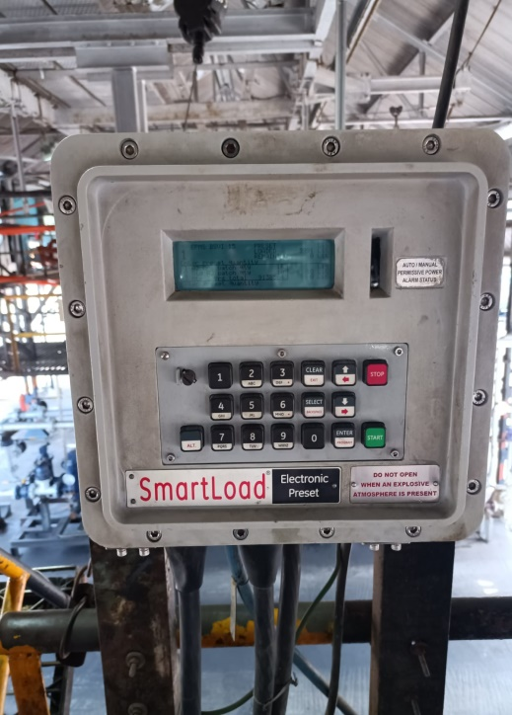
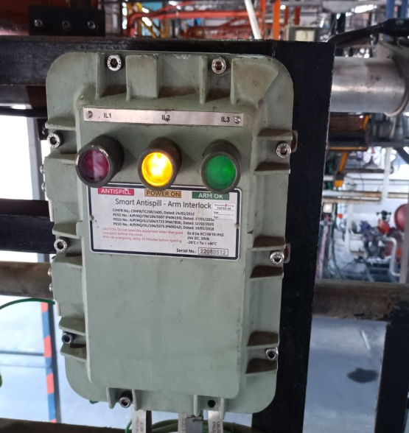
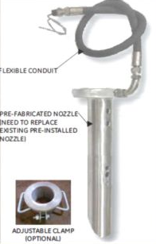
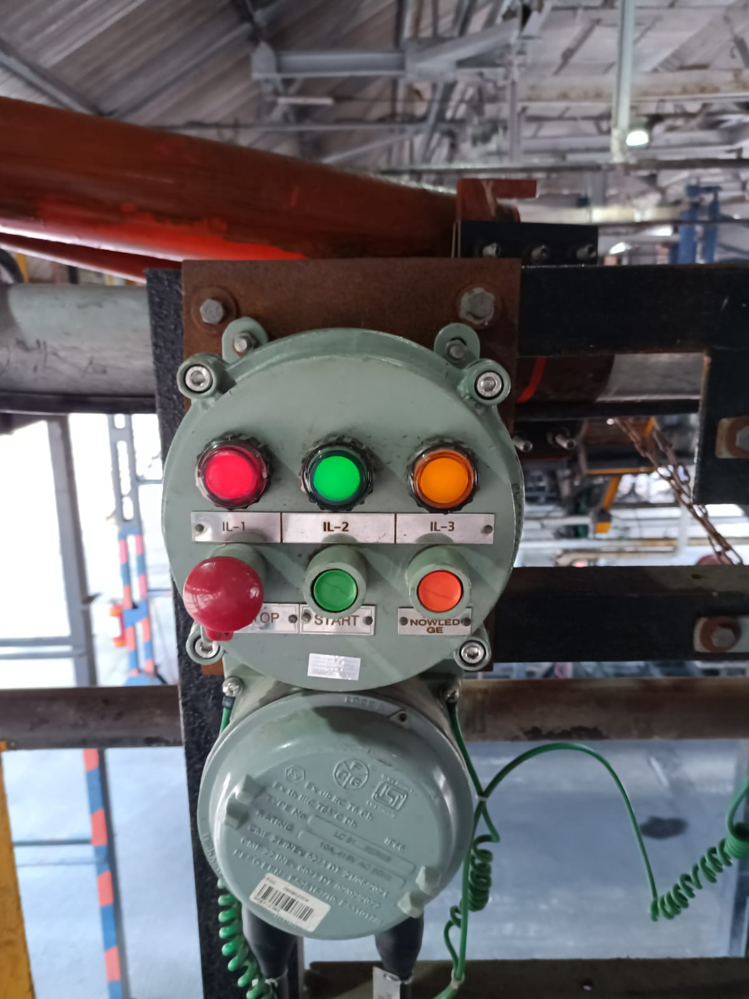
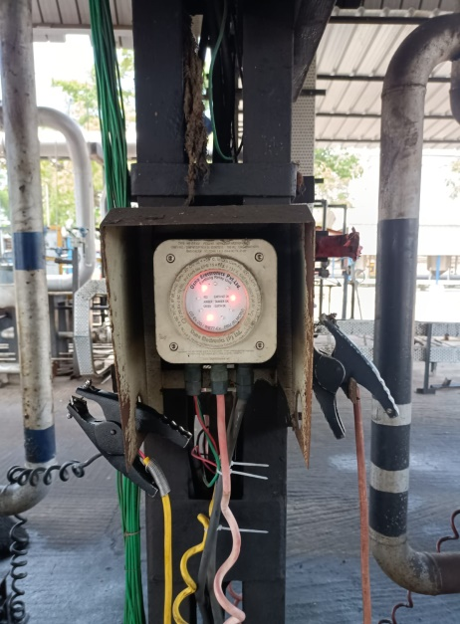
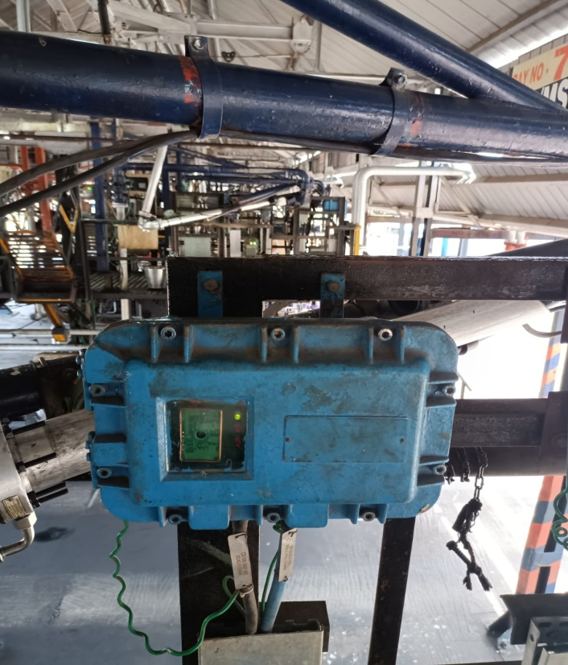
TANK LORRY FILLING SHED
Batch controller
Loading arm interlock sensor
Proximity card reader
Overspill detector
Flow meters
Digital control valve
Remote interaction terminal
Earthing relay

Slide 9
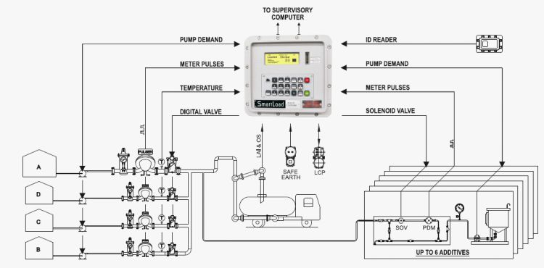

Slide 10
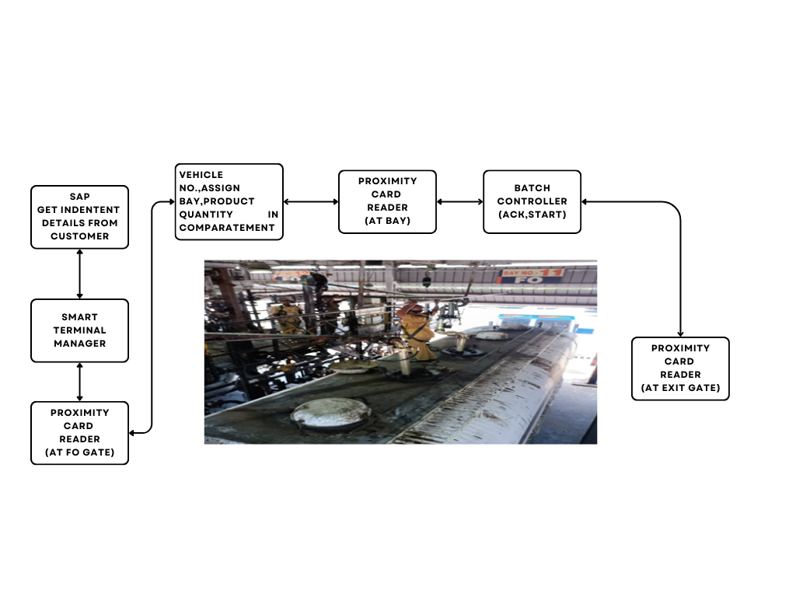

Slide 11
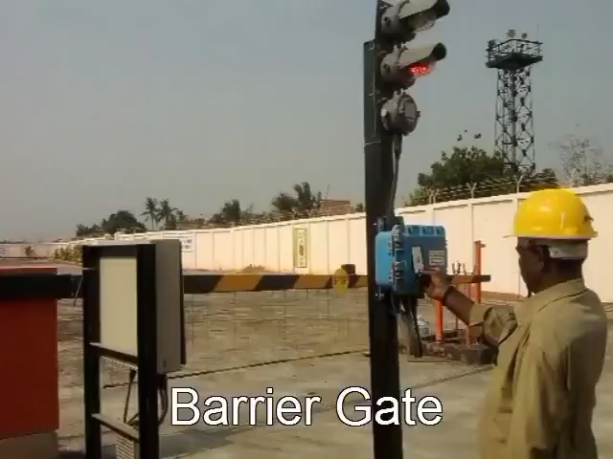
TERMINAL AUTOMATION SYSTEM

Slide 12
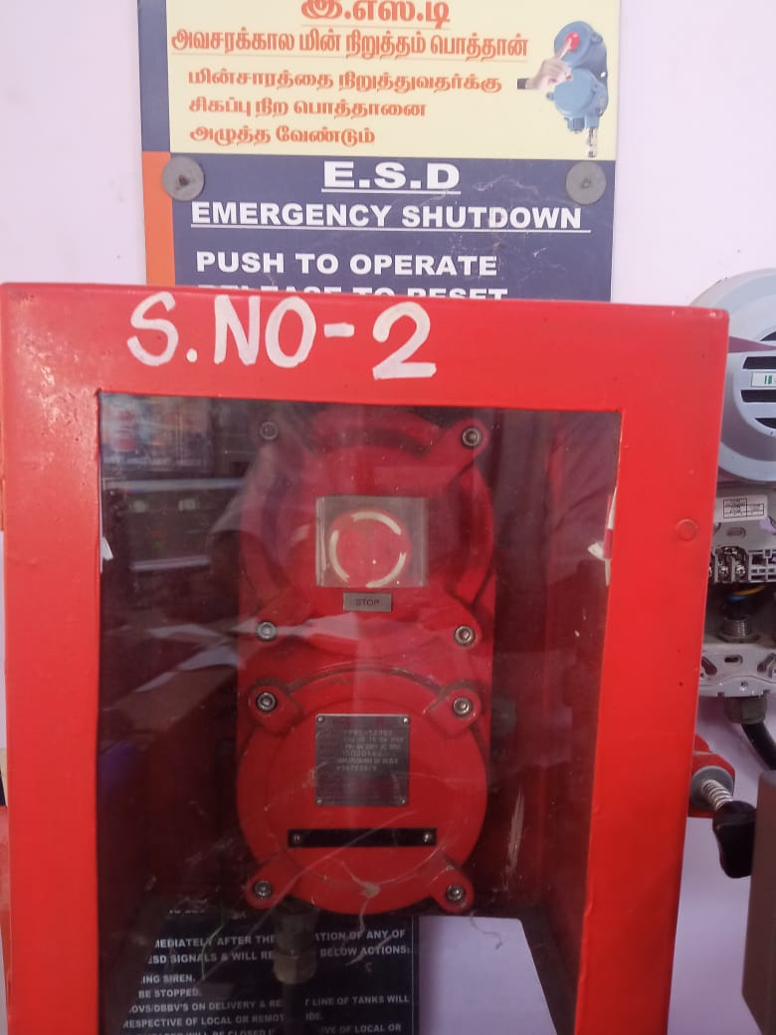
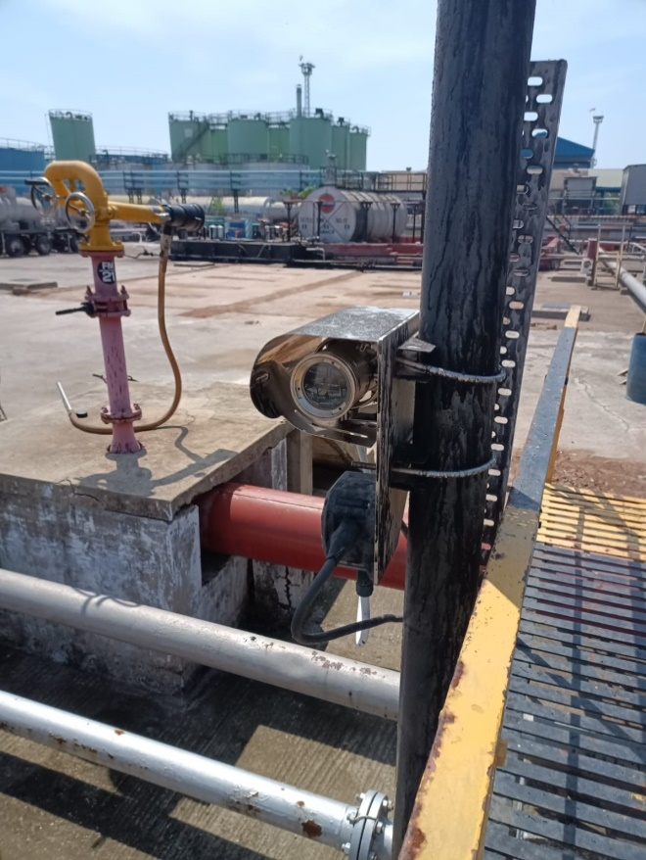
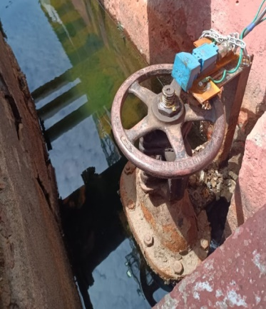
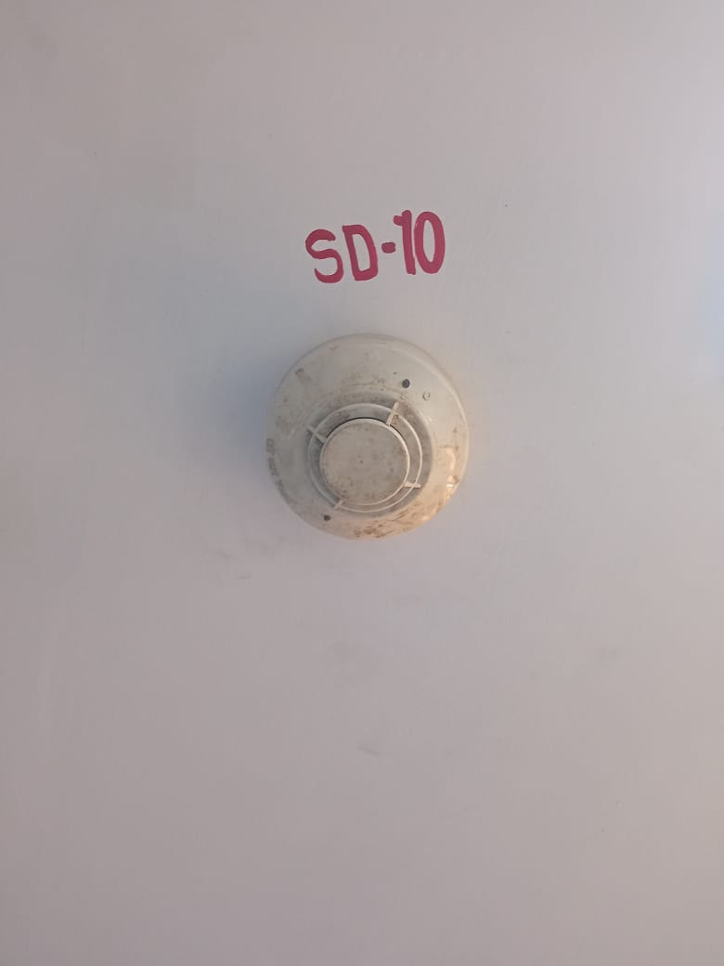
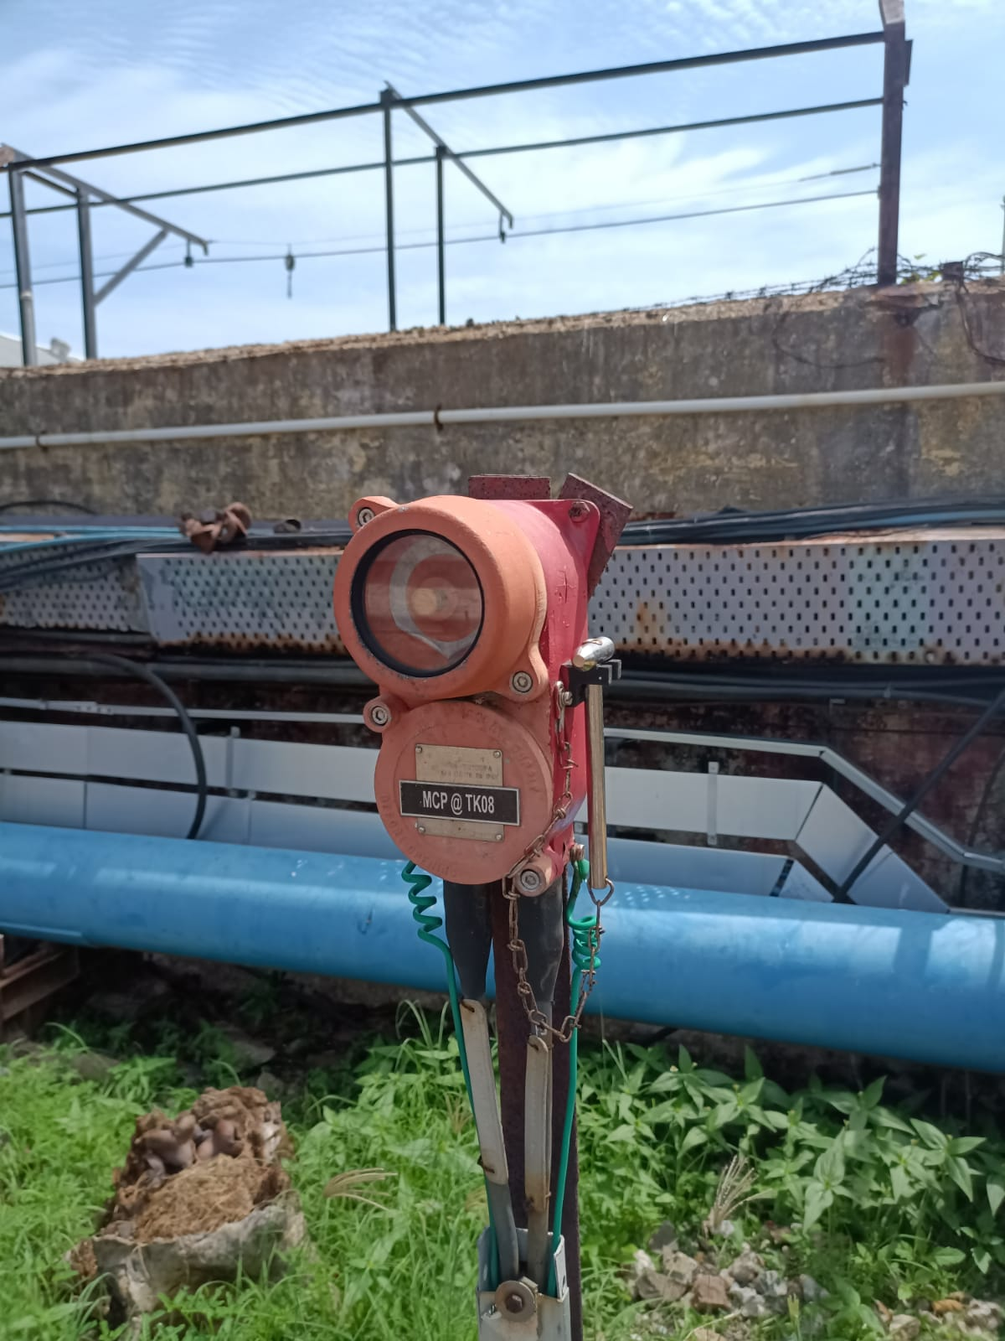
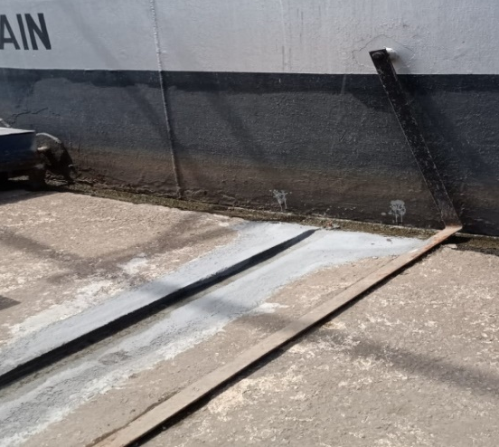
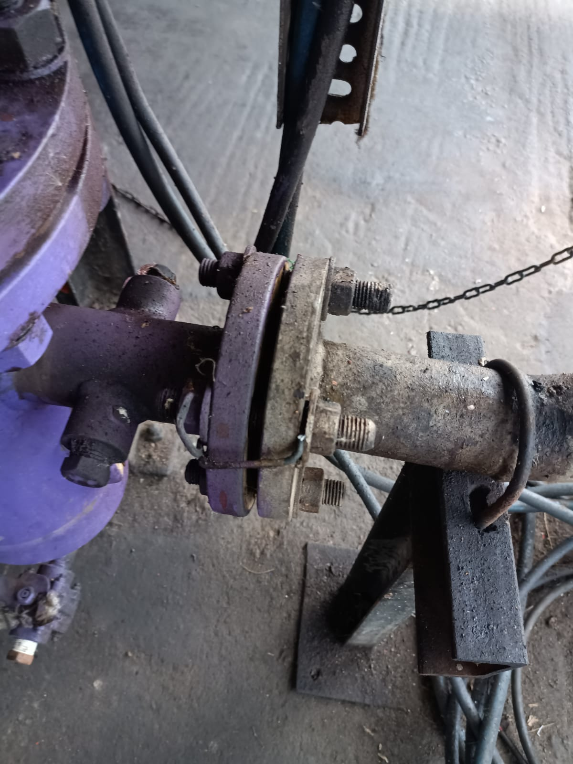
Safety
Emergency shutdown
Hydrocarbon detection system (HCD)
Dyke Valve Position Indicator
Smoke detector
Manual call point
Earthing
Non sparkle tools
Sprinkler System
Foam Pourer System
High-Volume Long Range Monitor(Hvlrm)
Fire Extinguishers
Safety drill

Slide 13
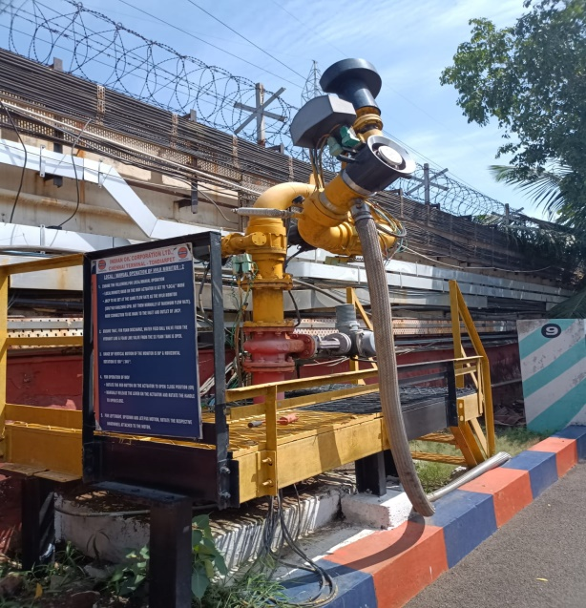
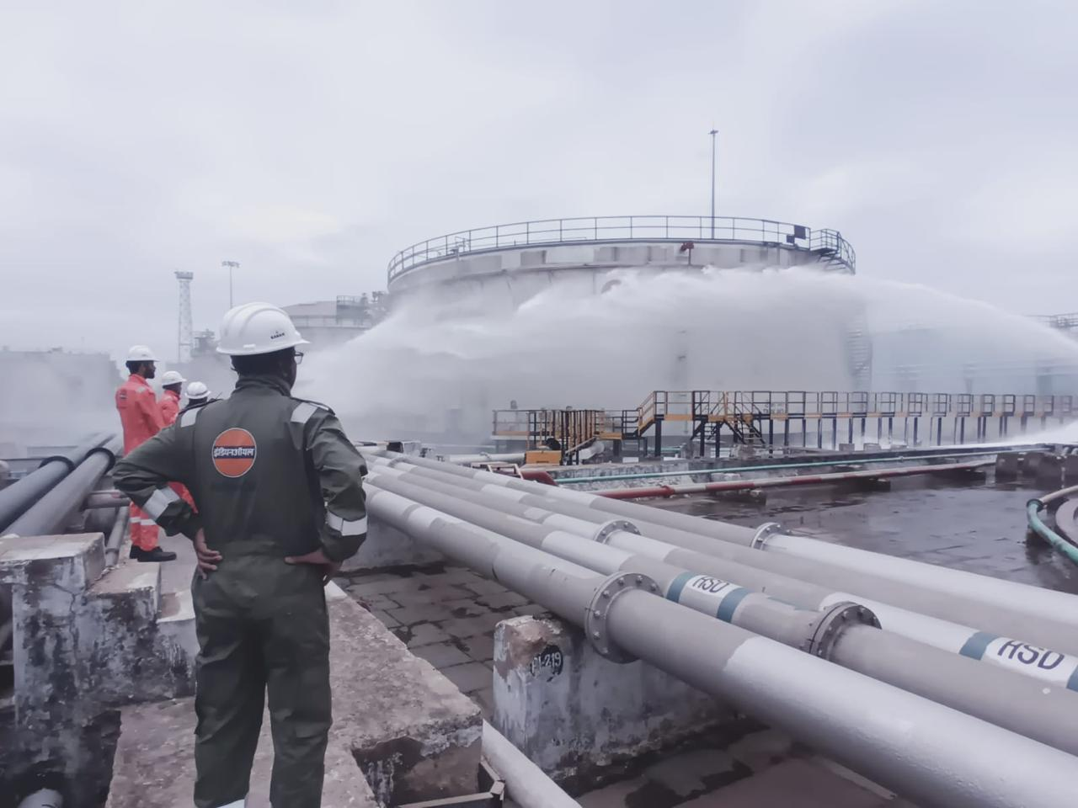
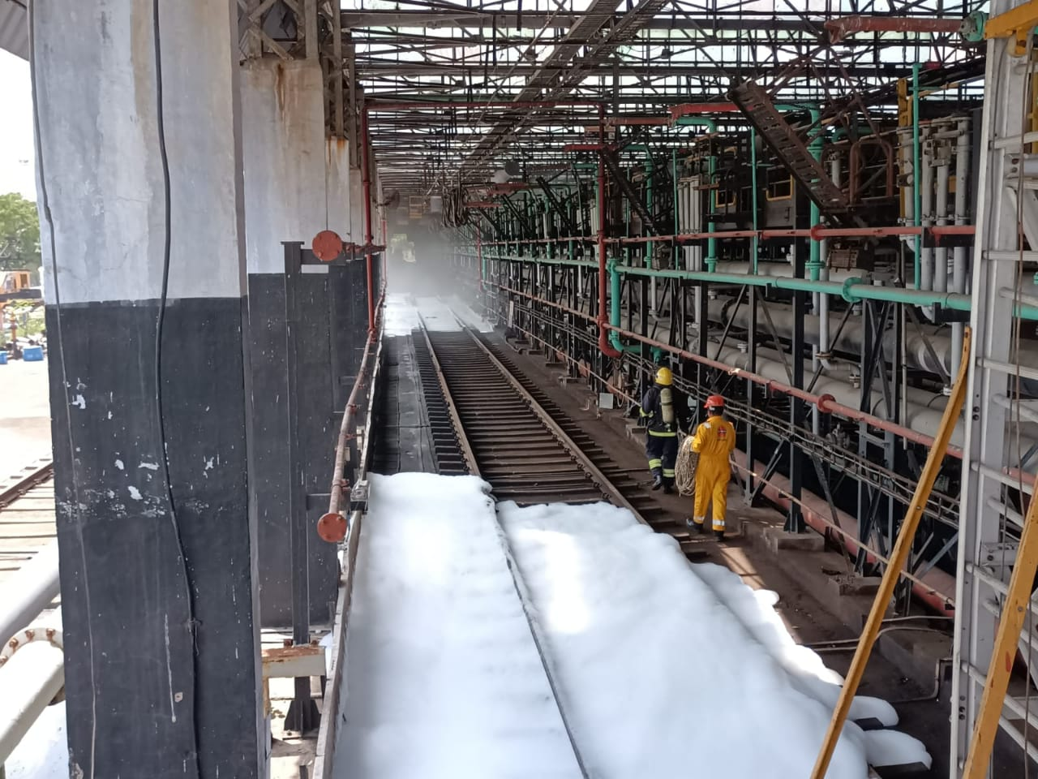
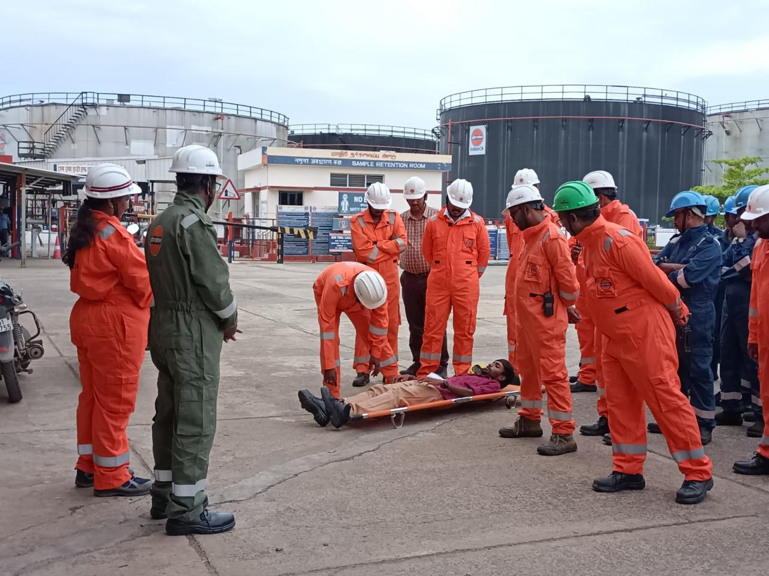

Slide 14
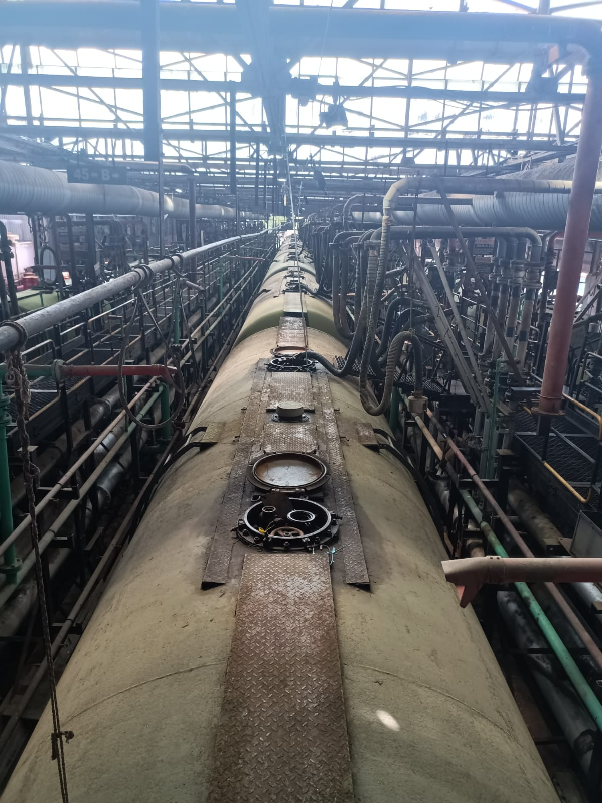
WAGON LOADIND

Slide 15
WORK DONE AT IOCL TONDAIRPET TERMINAL
Enhancing Fuel Delivery Accuracy through Automated Calibration of Positive Displacement Meters at Tondiarpet Terminal Bays for truck filling
CPU Card Replacement and Parameter Reconfiguration for Bay 3 Batch Controller
Installation of Magnetic Proximity Sensor for Dyke Drain Valve 10 on Tank
Testing and Verification of AOPS at Tanks 15 and 16 Systems at Various Locations in the Tank Farm

Slide 16
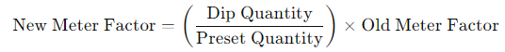
Enhancing Fuel Delivery Accuracy through Automated Calibration of Positive Displacement Meters at Tondiarpet Terminal Bays for truck filling
1)Setup the master PD meter skid and bays PD meter
2) Preset Values in batch controller
3) Preset ,delivery and dip quantity and note the reading of the quantities
4)
5) Batch Controller Configuration:
Press Alt + Clear.
Enter the passcode.
Click Setup.
6) Enter the new meter factors and related parameters
7) Check the accuracy

Slide 17
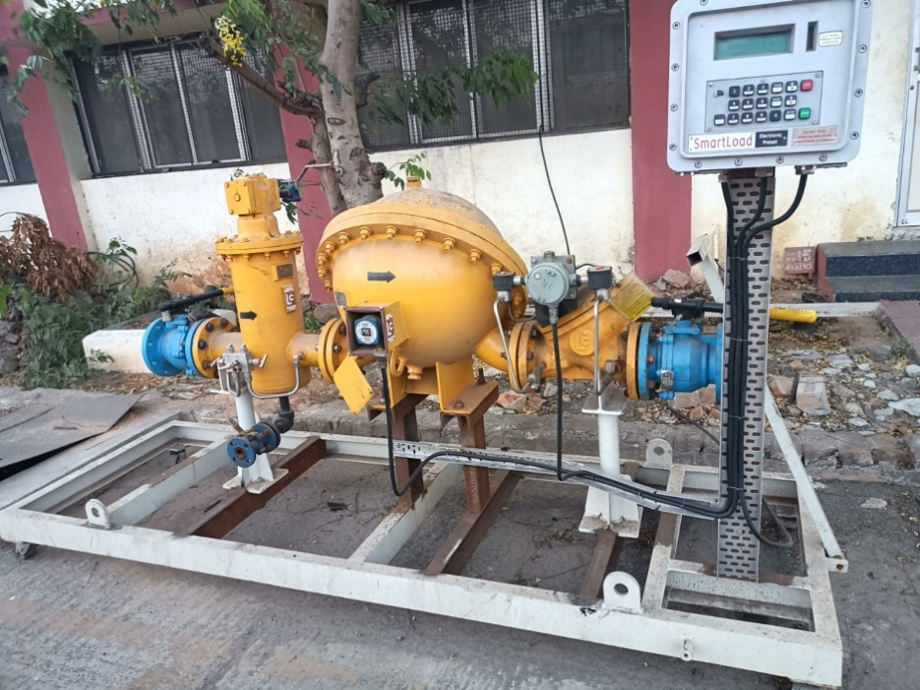
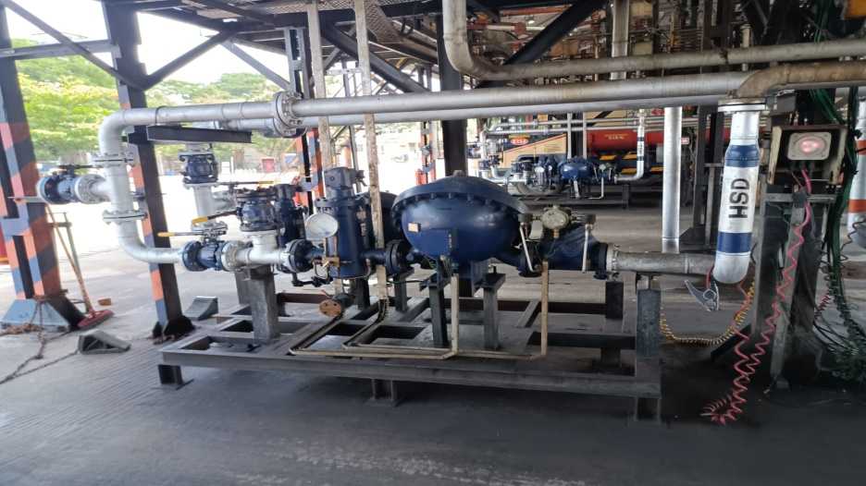

Slide 18
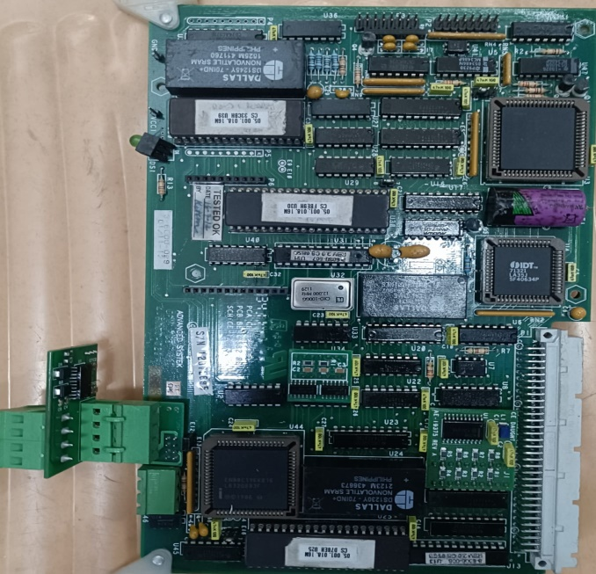
CPU Card Replacement and Parameter Reconfiguration for Bay 3 Batch Controller
1) Note Existing Parameters around 701
2) Replace the CPU Card by opening the batch controller
3) Enter Parameters into the New CPU Card:
Press Alt + Enter to access the parameter setup menu.
Enter the passcode to unlock the setup configuration.
Navigate to the setup section.
Enter all the noted parameters into the new CPU card manually.

Slide 19
Installation of Magnetic Proximity Sensor for Dyke Drain Valve 10 on Tank 2
APPARATUS REQUIRED:
OSNA Magnetic Proximity Sensor
Barrier Relay
Connecting Wire
Flange
WORKING PRINCIPLE:
The magnetic proximity sensor continuously supplies a 4V signal. When a change in the dyke drain valve position is detected, the sensor outputs 8V to the barrier relay. The barrier relay then amplifies this 8V signal to 24V
STEPS:
1) Placement of Magnetic Proximity Sensor at correct position
2) Connecting to 1,3 as input to barrier relay, supply at 9(-), 12(+) and 7,8output of barrier relay to Honeywell PLC
3) Even a small disturbance occur in the dyke drain valve handle
The hooter alarm rings

Slide 20
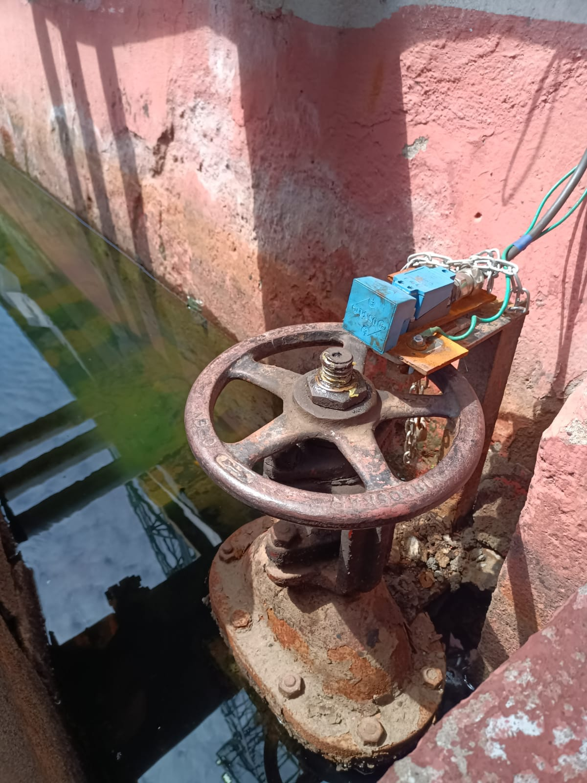
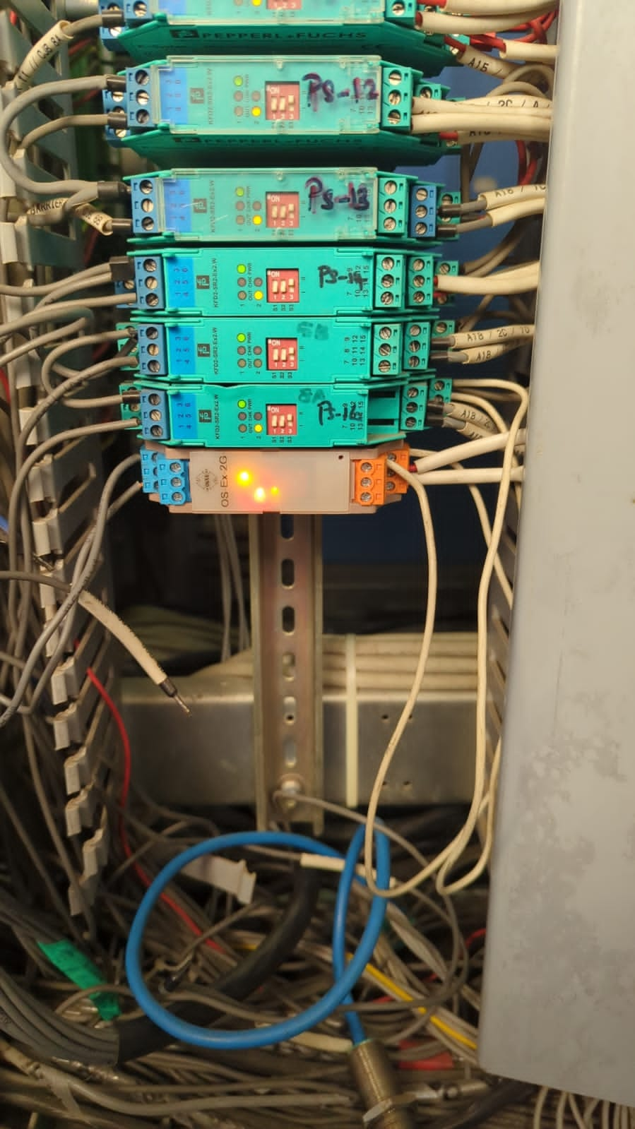

Slide 21
Testing and Verification of AOPS at Tanks 15 and 16 Systems at Various Locations in the Tank Farm
Apparatus Required:
Non-sparkle tools to remove AOPS
Bucket of water
Steps:
1) Force AOPS in Station SCADA and Verify ROSOV Initial State
2) Safely Remove AOPS and disable force condition
3) Test AOPS in Water Bucket:
Place the AOPS in a bucket of water.
Observe if the ROSOV closes. If the ROSOV does not close, the AOPS is not functioning correctly and needs replacement

Slide 22
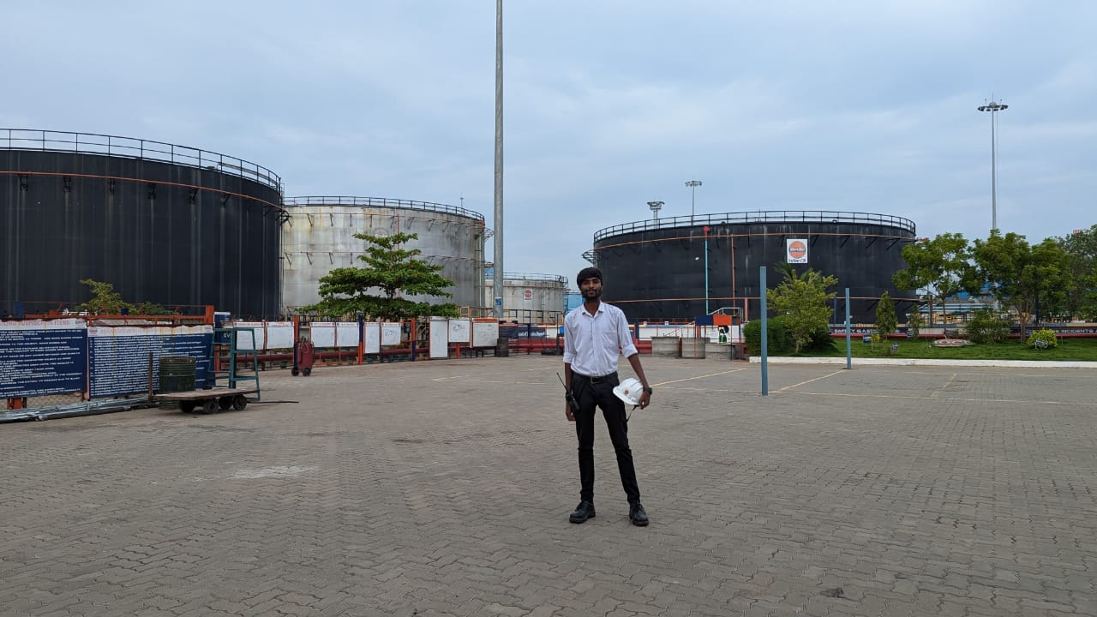
THANK YOU

